Slide 1

3D Reconstruction in Dynamic Environments
Mr. Yue Bo & Mr. Zhang Chi

Slide 2
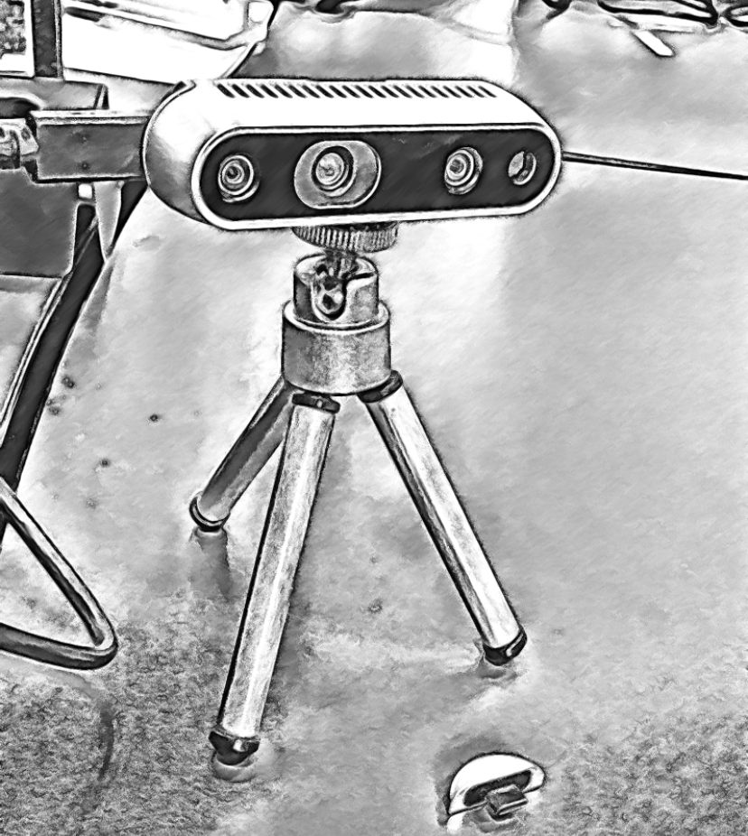
3D Reconstruction in Dynamic Environments
Dynamic
Detect moving objects in static background
Generate masks to eliminate dynamics
Inpaint the static occluded background using pose transformation
Reconstruction
Hallucinate plausible imagery to 3D world coordinate backhhhh

Slide 3
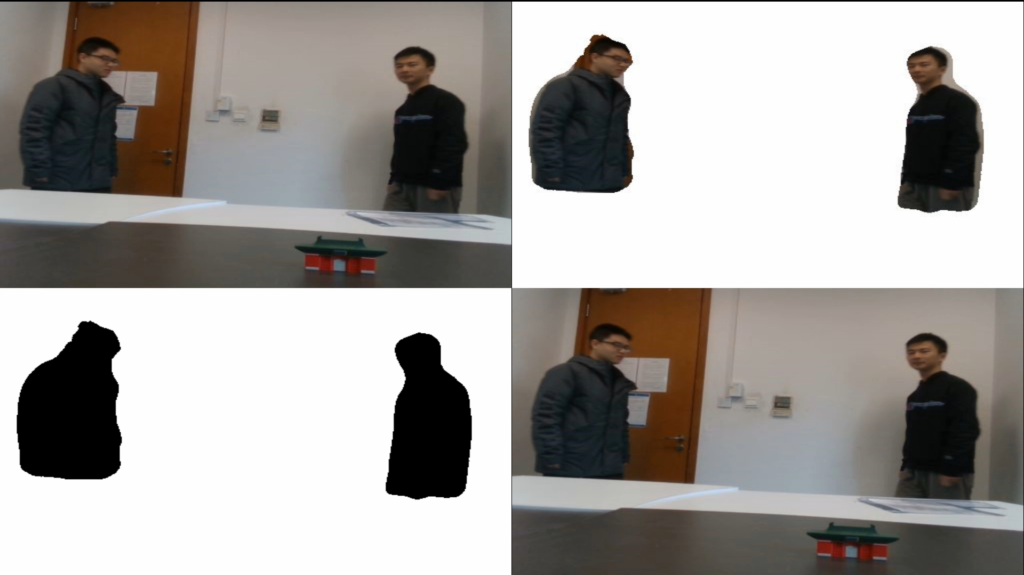
Demo
Original
Dynamics
Masks
Final

Slide 4
Why DynaSLAM Important?
VR & AR needs static & tidy background
Recognition for lifelong mapping

Slide 5

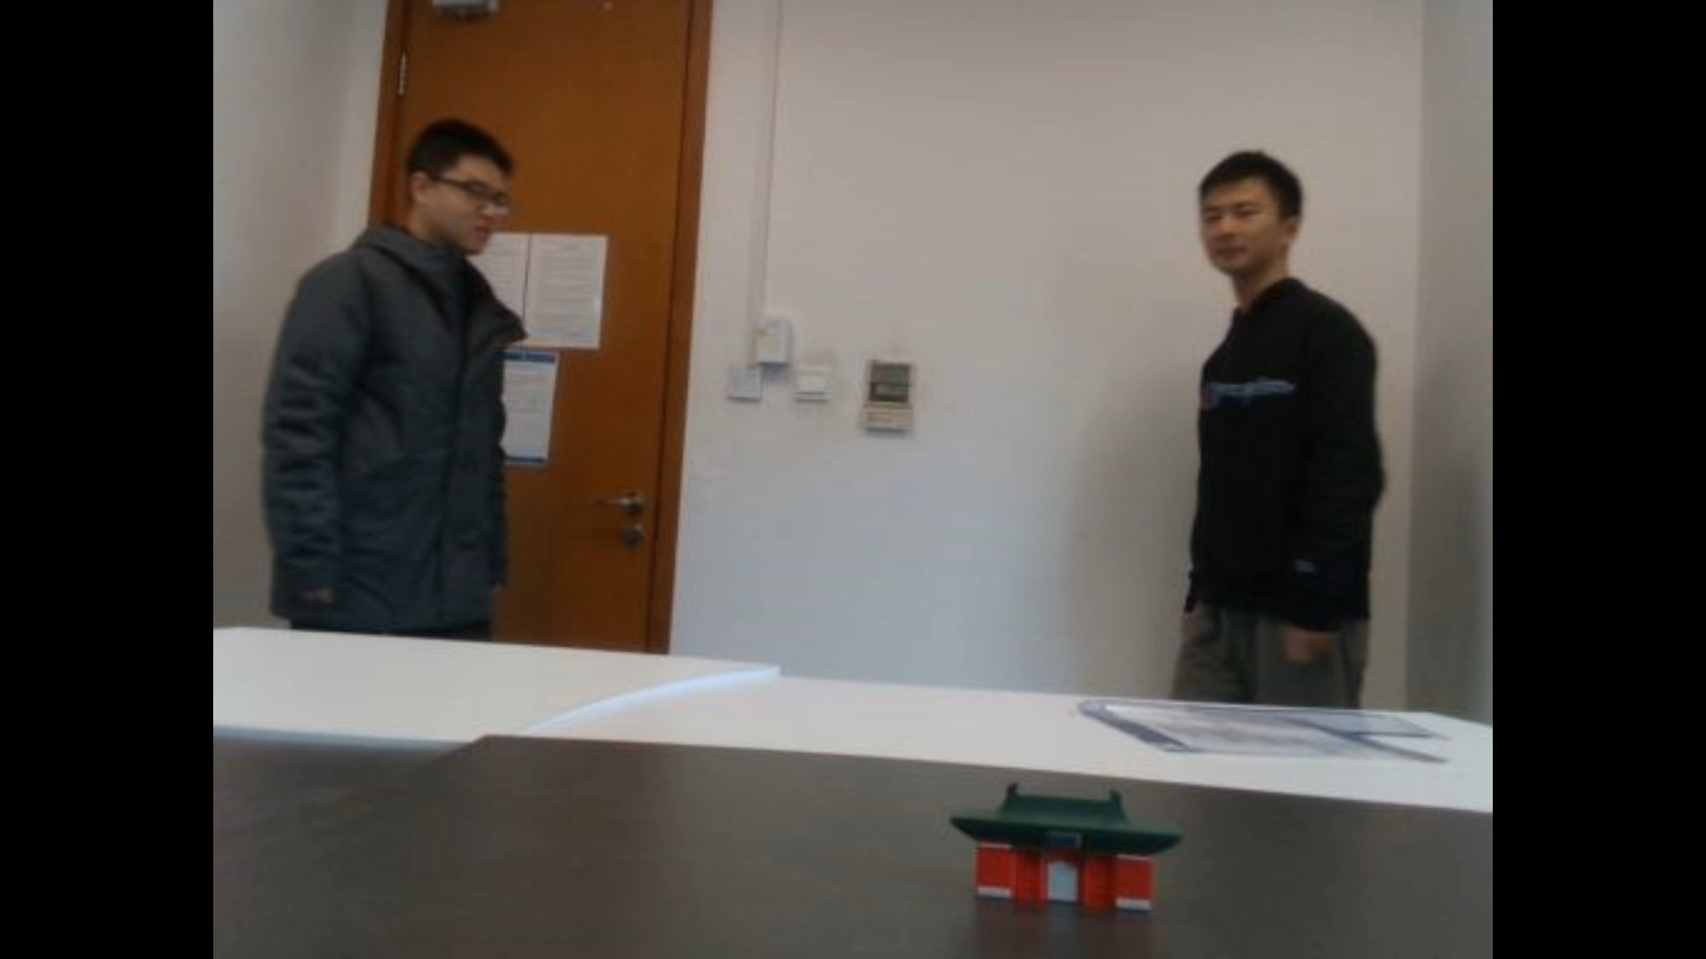
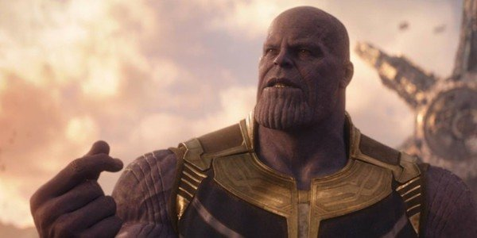
In short, we simply snap fingers to disappear all dynamic objects
Thanos
We disappeared, save us, plz!!!

Slide 6
Innovative Points of Our Research
1. Use a mask net instead of residuals to generate dynamic masks
2. Use a pose net instead of ORB-SLAM2 to provide pose estimations
*mask net & pose net are for dynamics

Slide 7
Part I: Dynamic

Slide 8
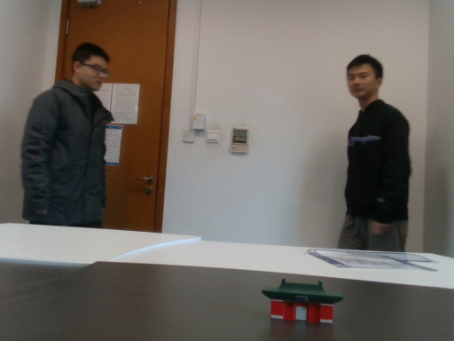
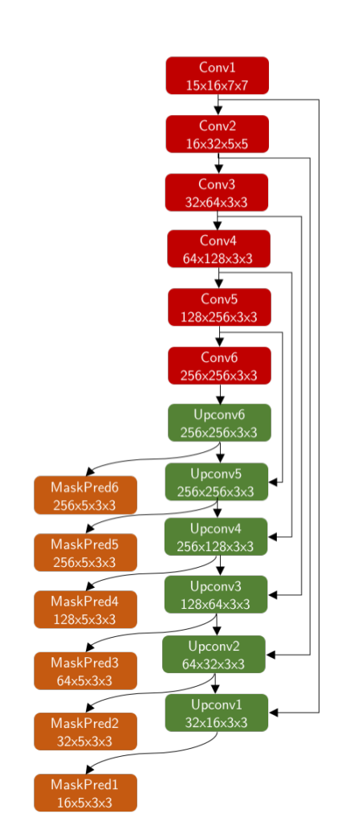


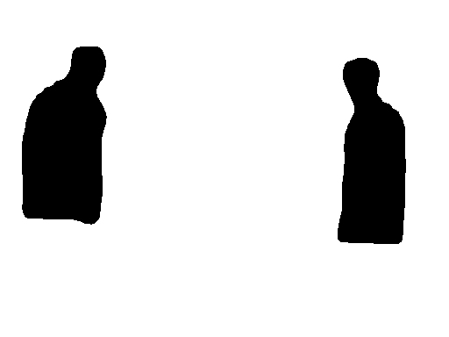
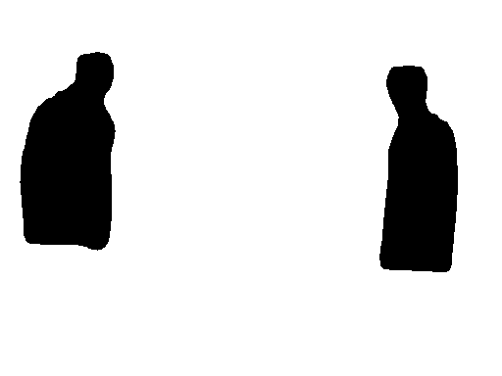
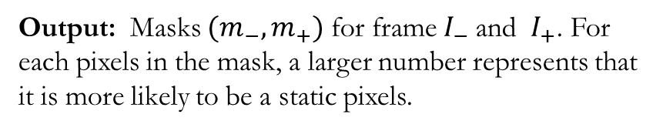
Network for Mask: MaskNet^{[1]}
Input: Three consecutive images of frames $(I_{−}, I, { I}_{+})$
Output: Masks $(m_{−},m_{+})$ for frame $I_{−}$and ${ I}_{+}$. For each pixels in the mask, a larger number represents that it is more likely to be a static pixels.

Slide 9
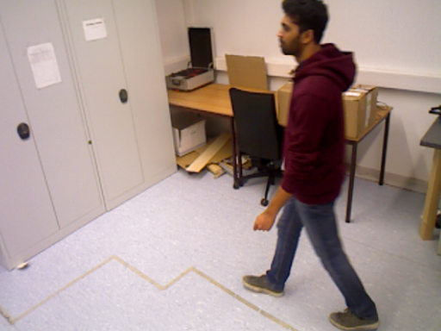
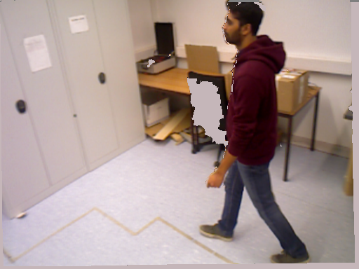
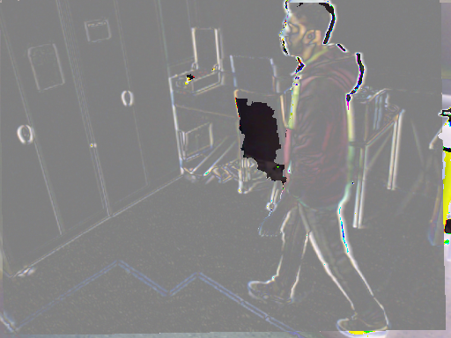
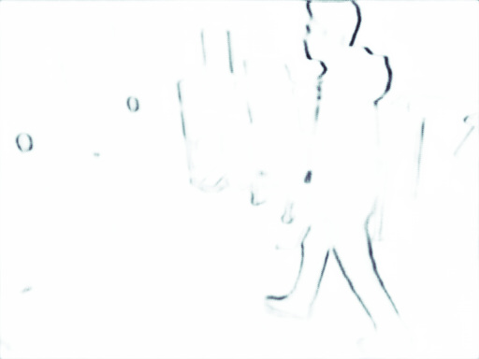
How to train the mask network?
Failed Attempt 1:
Idea: Use the residuals between projected frame and raw frame
Analysis of failure: only edge of persons can be recognized
raw image
warped image
residual image
residual mask
* the chair in warped image is in gray because of the noise in depth estimation, which will be removed in our system

Slide 10
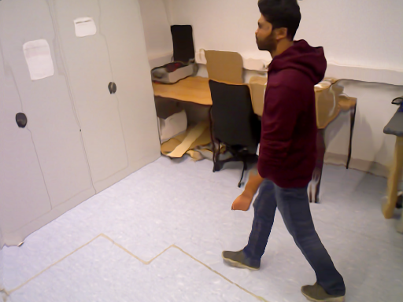
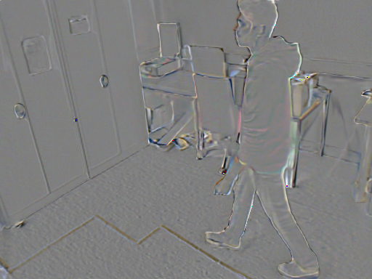
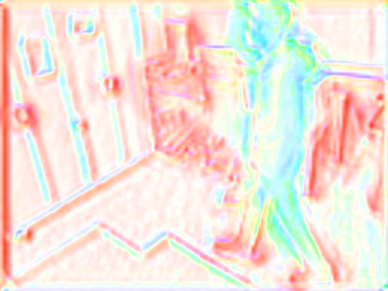
How to train the mask network?
Failed Attempt 2:
Idea: Use an extra optical flow network to provide optical flow
Analysis of failure : it’s very difficult to train an optical flow network
raw image
warped image
residual image
optical flow

Slide 11
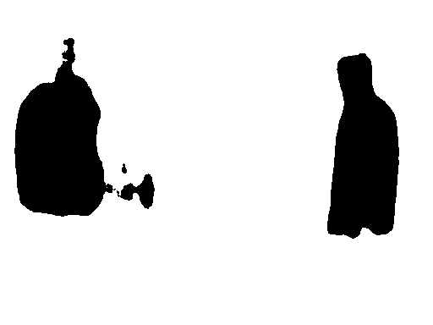
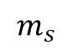
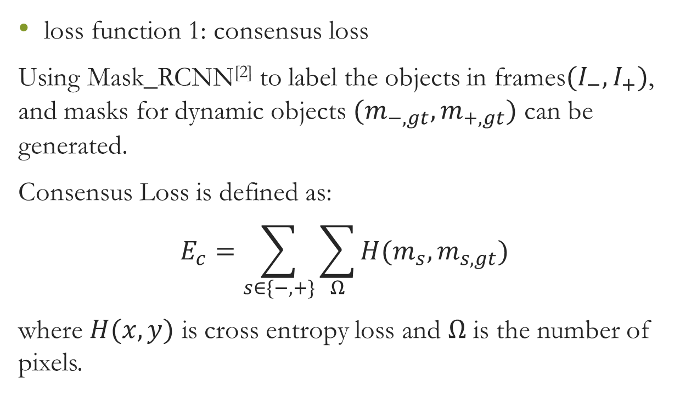
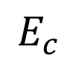
Loss functions for the mask network
loss function 1: consensus loss
Using Mask_RCNN^{[2]} to label the objects in frames$(I_{−},I_{+})$, and masks for dynamic objects $(m_{−,gt},m_{+,gt})$ can be generated.
Consensus Loss is defined as:
$$E_{c}=\sum_{s∈\{−,+\}}{\sum_{Ω}{H(m_{s}, m_{s,gt})}}$$
where $H(x,y)$ is cross entropy loss and $Ω$ is the number of pixels.
label
$$E_{c}$$
$$m_{s}$$

Slide 12

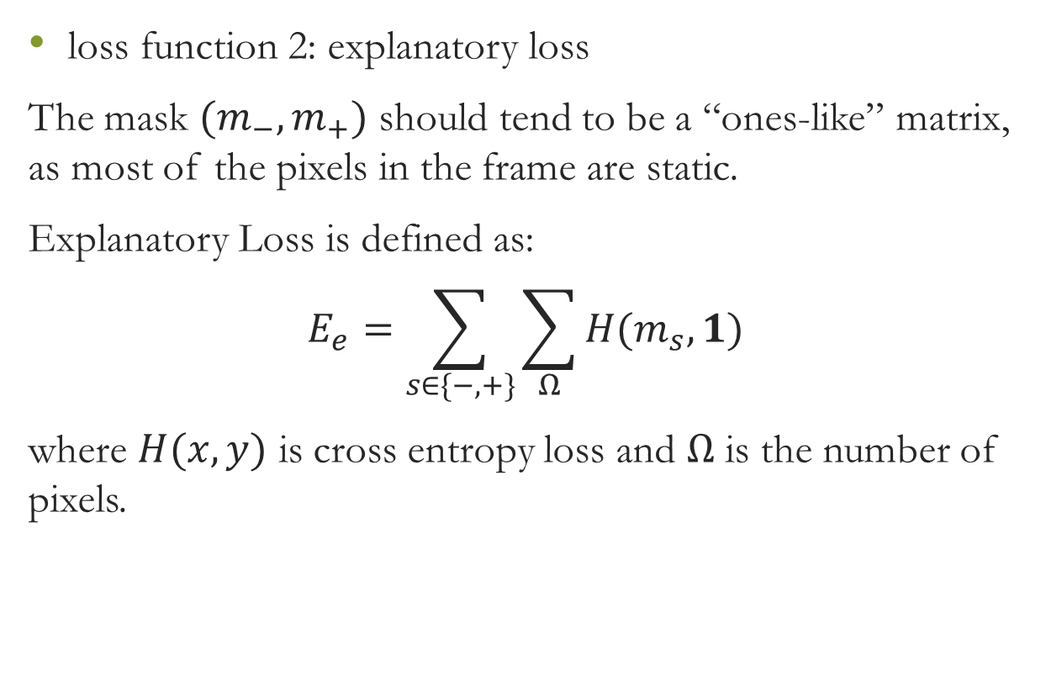
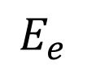
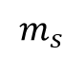
Loss functions for the mask network
loss function 2: explanatory loss
The mask $(m_{−},m_{+})$ should tend to be a “ones-like” matrix, as most of the pixels in the frame are static.
Explanatory Loss is defined as:
$$E_{e}=\sum_{s∈\{−,+\}}{\sum_{Ω}{H(m_{s},1)}}$$
where $H(x,y)$ is cross entropy loss and $Ω$ is the number of pixels.
$$1$$
$$E_{e}$$
$$m_{s}$$

Slide 13
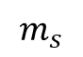
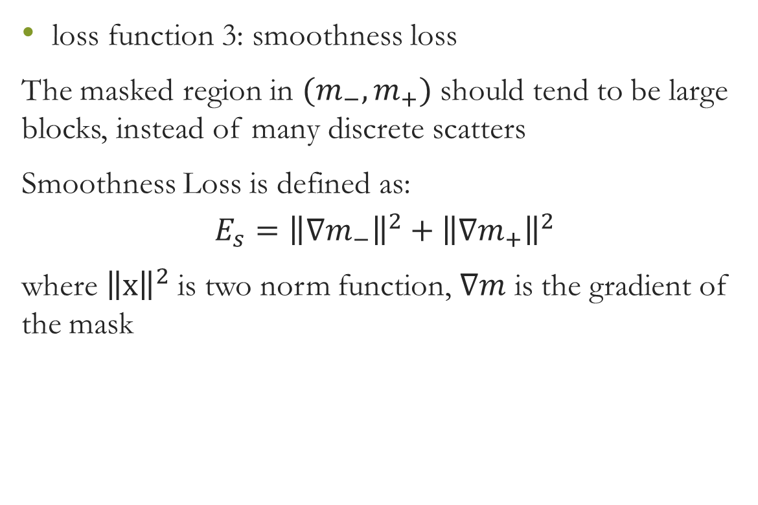
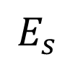
Loss functions for the mask network
loss function 3: smoothness loss
The masked region in $(m_{−},m_{+})$ should tend to be large blocks, instead of many discrete scatters
Smoothness Loss is defined as:
$$E_{s}={\left\|∇m_{−}\right\|}^{2}+{\left\|∇m_{+}\right\|}^{2}$$
where ${\left\|x\right\|}^{2}$is two norm function, $∇m$ is the gradient of the mask
$$m_{s}$$
gradient
$$E_{s}$$

Slide 14
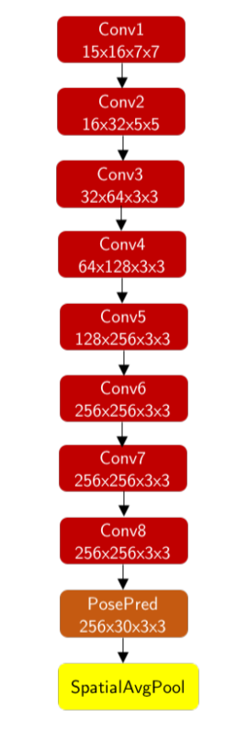
Network for Pose: PoseNet^{[3]}
Input: Three consecutive images of frames $(I_{−}, I, { I}_{+})$
Output: Pose transformation from frame $(I_{−},I_{+})$ to frame $I$

Slide 15
How to train the pose network?
For any two consecutive frames, with pose transformation, the first frame can be projected into the second frame.
point cloud in first coordinate
previous RGB image
camera model
previous
depth image
pose transformation
camera model
a projected RGB image in second frame
point cloud in second coordinate

Slide 16
How to train the pose network?
In the static region of the image, the warped image which is transformed with pose should be same to the raw image.
The differences in the static region can be used to compute a loss
raw image
warped image
residual image

Slide 17
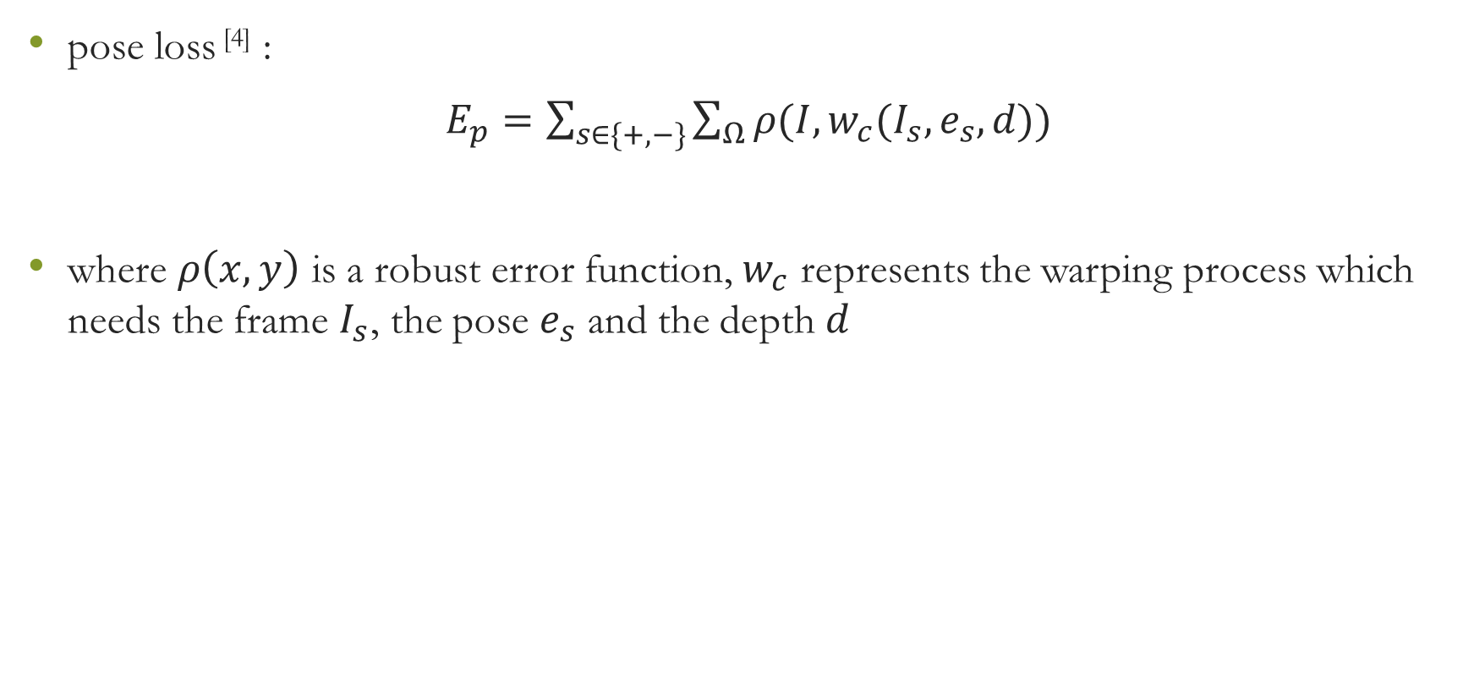
Loss functions for the pose network
pose loss ^{[4]} :
$E_{p}=\sum_{s∈\{+,−\}}{\sum_{Ω}{ρ(I,w_{c}(I_{s},e_{s},d))}}$
where $ρ\left(x,y\right)$ is a robust error function, $w_{c}$ represents the warping process which needs the frame $I_{s}$, the pose $e_{s}$ and the depth $d$

Slide 18
Part II: Reconstruction

Slide 19
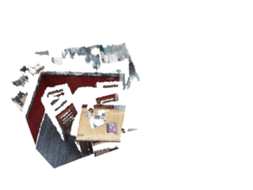
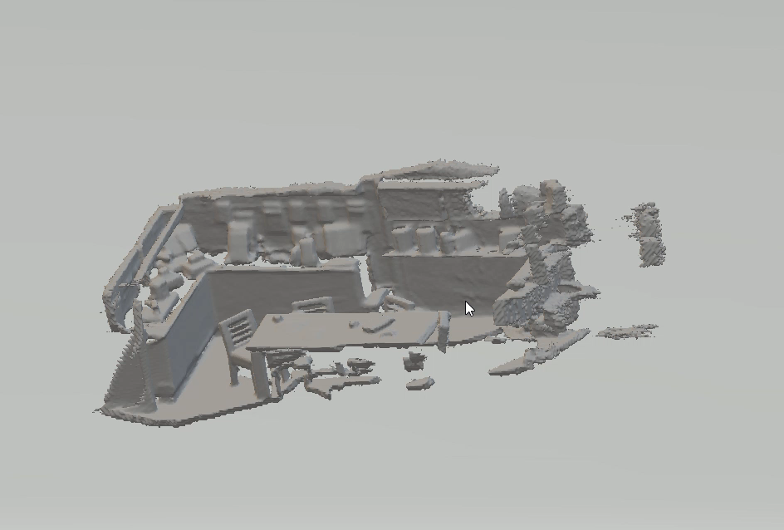
Truncated Signed Distance Function（TSDF）
TSDF is applied to project the union set of point clouds of all RGBD images to a world coordinate.

Slide 20
Reference:
[1] T. Zhou, M. Brown, N. Snavely, and D. G. Lowe. Unsupervised learning of depth and ego-motion from video. In CVPR, volume 2, page 7, 2017
[2] Waleed Abdulla. Mask r-cnn for object detection and in-stance segmentation on keras and tensorflow.https://github.com/matterport/Mask_RCNN, 2017.
[3] A. Kendall, M. Grimes, and R. Cipolla. Posenet: A convolutional network for real-time 6-dof camera relocalization. In Proceedings of the IEEE international conference on computer vision, pages 2938–2946, 2015.
[4] Z. Wang, A. C. Bovik, H. R. Sheikh, and E. P. Simoncelli. Image quality assessment: from error visibility to structural similarity. IEEE transactions on image processing, 13(4):600– 612, 2004

Slide 21
Thanks for listening！
Q & A

